Slide 1
Kingswood Year 2 residential 9-10th April 2019
“There is no better way to help a child than to inspire them, and an unforgettable residential trip can do just that. It can offer a wonderful opportunity to open minds and nurture potential, to teach life skills, build confidence and create a better understanding of the world. Spending time away from home can also offer young people a chance to embrace adventure and take calculated risks, face new challenges, build self-esteem and make lifelong friends along the way.”

Slide 2
Teachers attending the trip
Mrs McCarty
Miss Sutton
Mr Carr

Slide 3
On the morning of the trip
The coach will leave the school at 7.45am in the morning so that we can arrive at the centre by 9am ready for the fun to begin.
School will be open for children to enter from 7.15am.
Children must have arrived by 7.30 at the latest so that we can check any medical forms and get all of the luggage and snack bag ready in one place.
Any medication must be held separately to their main bag and be labelled clearly with your child’s name. A member of staff will be ready to take this from you along with any other information that you need to give.
You will also have the opportunity to hand in a small amount of pocket money (£5) in a named wallet to the teachers.

Slide 4
What to wear
Light weight trousers/ joggers – NOT shorts
T-shirt – long sleeved
Jumper
Waterproof coat
Trainers – that you don’t mind getting a little dirty
No skirts/ expensive clothes/ smart shoes

Slide 5
What to pack
As this is only an over-night stay you will not need to send your child with too much luggage.
Your information pack includes a suggested list of things they will need;
Toiletries (soap, tooth brush and tooth paste)
Small towel
Pyjamas /night wear/ slippers
Two pairs of pants and socks
Two changes of clothes (Joggers, t-shirts, jumper)
Plastic bag for any dirty clothes
A second pair of trainers
Water bottle
Teddy etc if needed
You will also need to include a separate snack and drink for them when they arrive, as there will be a long gap between you giving them breakfast and them providing lunch.
Other than that, no other food is necessary – we will make sure that they get everything that they need.

Slide 6
Sleeping
Your child will find welcoming rooms in their dormitory style accommodation, which has a daily housekeeping check to ensure everything stays clean and comfortable.
All dormitories are gender separated and house 2 to 16 in bunk beds where clean duvets and pillows are all provided. Some rooms are en-suite but there are always separate toilet and shower facilities for guests close to dormitories.
All staff will be located in rooms next to the children and available 24 hours if needed.

Slide 8
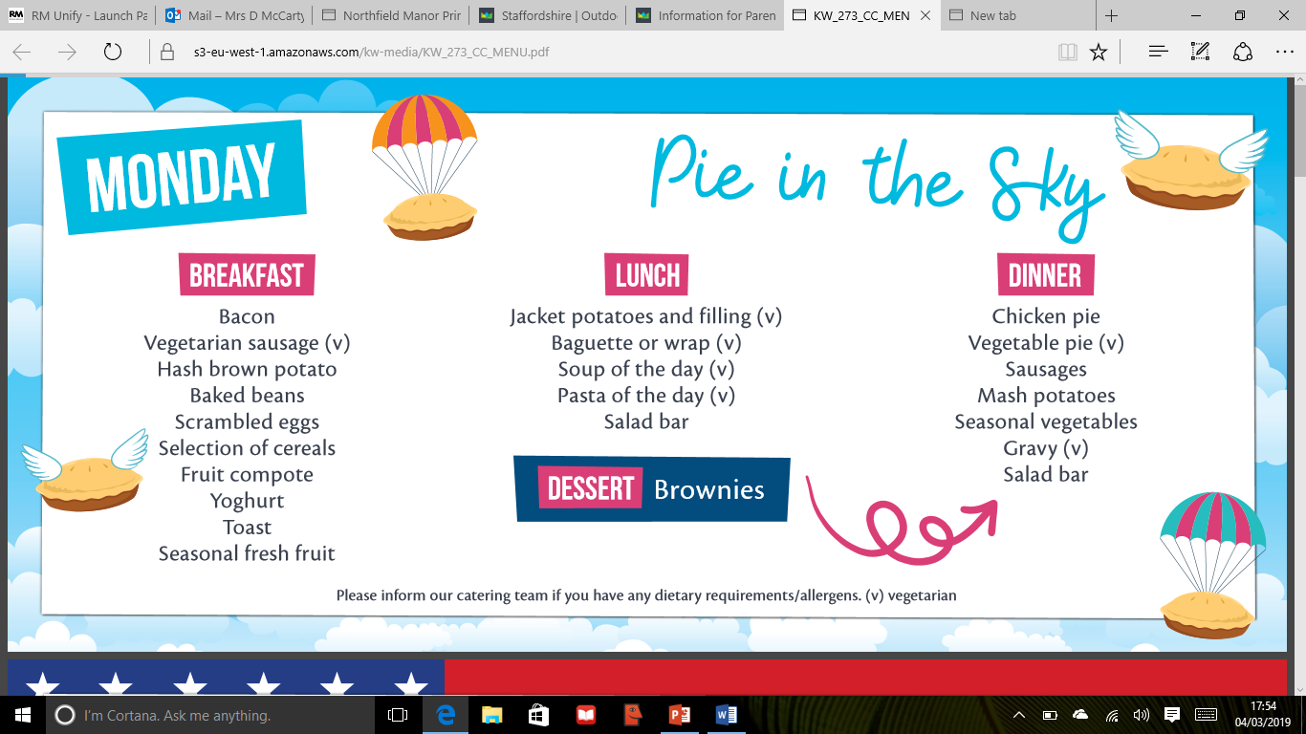
Food
To keep the young adventurers going they serve three freshly prepared, healthy, buffet style meals each day, with plenty of variety available - including hot and cold meals, a salad bar and plenty of water available at all times.
They cater for all faith and dietary requirements. If your child has any special requirements you can let us know on the forms in your information pack. We will then pass the information on.

Slide 9
Activities

Slide 10
Safety and staff
All Kingswood staff are vetted, inducted and trained to the highest levels
All staff complete a comprehensive induction programme that includes safeguarding training
Throughout their employment with Kingswood all staff are monitored to ensure compliance with our health & safety procedures
All activities have rapid access to first aid trained staff and facilities
Instructors are trained to recognise each individual child’s own capabilities & teach to his/her individual level & pace
All staff wear identification badges and uniforms at all times, with all visitors and teachers required to wear a security badge
Safety and standards
Every Kingswood centre is independently inspected by the British Activity Providers Association (BAPA)
We also conduct rigorous internal health and safety audits
We operate comprehensive risk assessments on all activities
We are fully responsible for all emergency procedures, safety systems and security arrangements at each centre

Slide 11
Safety and supervision
For most activities children are placed into groups of no more than 15
Our strict supervision policy ensures that children are always accompanied by Kingswood instructors. Between 9.00 pm and 9.00 am and at meal and break times they are supervised by their teachers. Teachers are in loco parentis throughout the visit
Kingswood campuses have secure and clearly defined boundaries. Some centres have CCTV in operation
Teacher and party leader rooms are situated close to their students
The Kingswood Duty Manager and first-aiders are on call 24 hours a day

Slide 12
We will leave Kingswood at 1pm and should be back around 2pm.
A text will be sent out to parents to give an arrival time. You are free to pick up your child, or leave them with us until normal pick up time/ after school club.

